Slide 1
Macro Photography
An Introduction

Slide 2
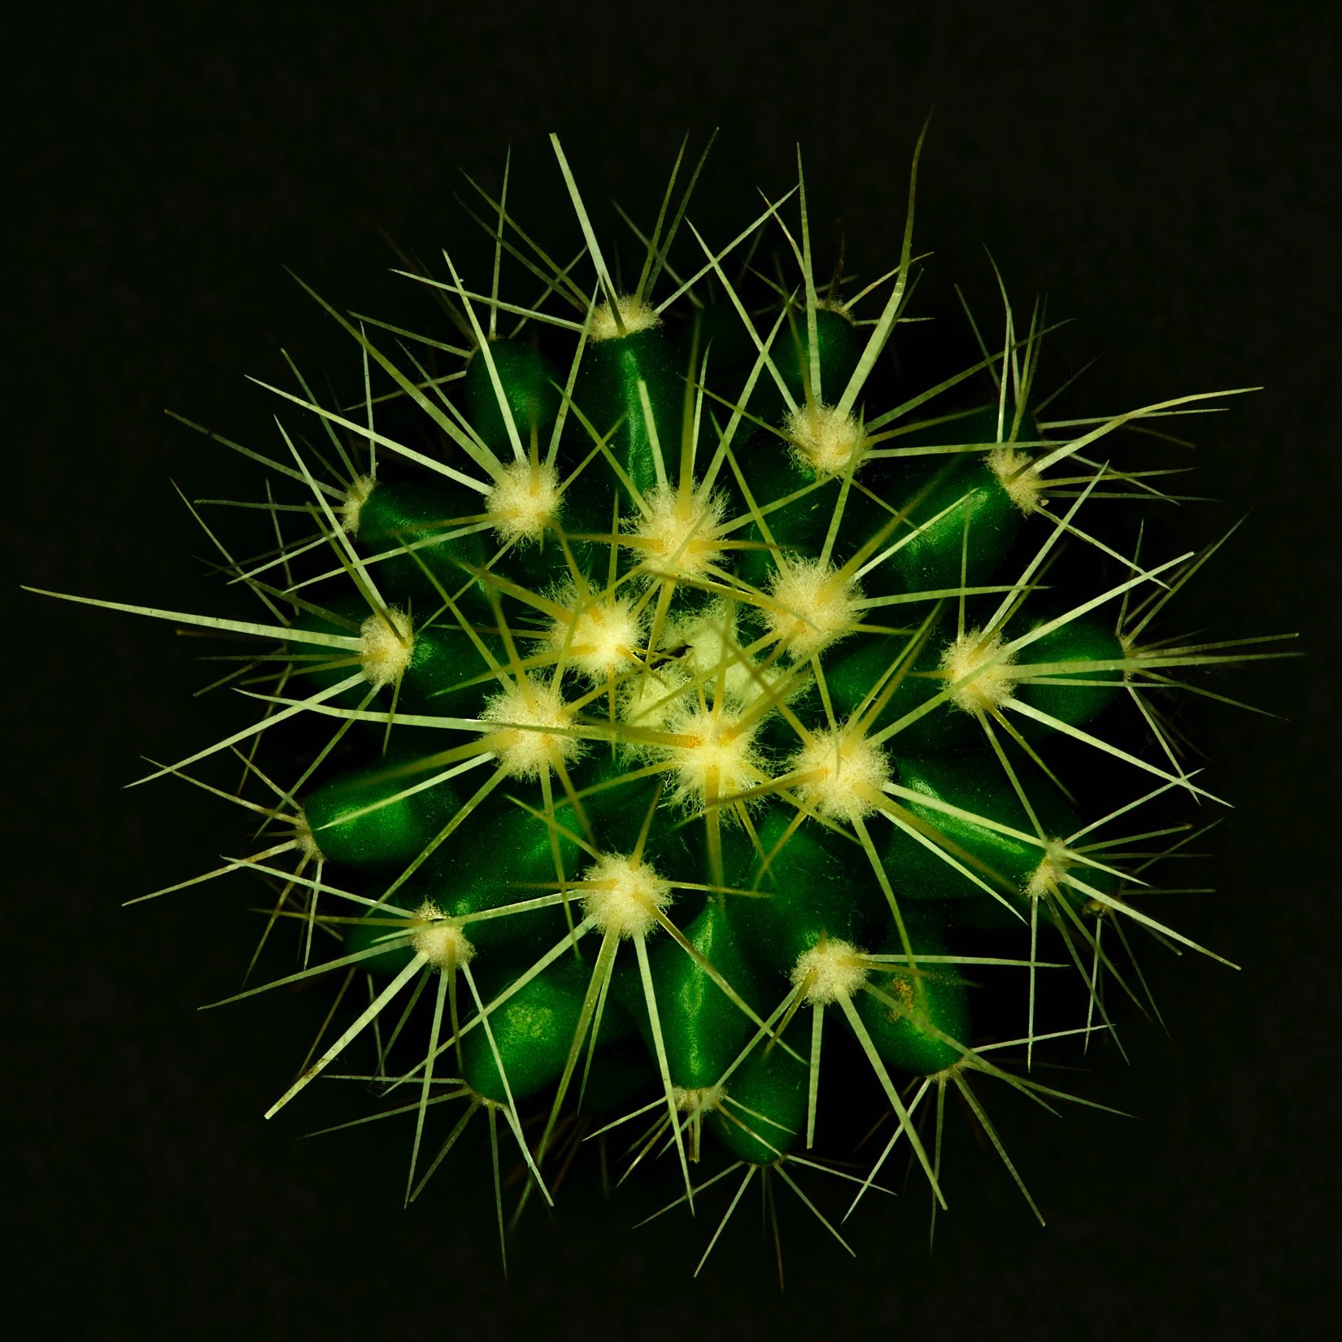
Macro Photography
Macro photography is close-up photography where the size of the subject is life-size or greater.

Slide 3
Equipment – the basics
Camera
Tripod
Instruction book for your camera

Slide 4
Useful but non essential equipment
Reflector that can double as a background
Torch
Backgrounds
Clamps & Plamps
Brushes to clean up subjects
Spray bottle of water

Slide 5
Specialist Equipment
Close-up filters
Extension tubes
Bellows
Reversing rings
Macro lenses, usually prime lenses usually with focal length in 3 groups 45-65mm, 90-105mm, 150-200mm

Slide 6
Close-up Filters
Low cost
Very portable
Reduces image quality particularly if stacked
Suffers from chromatic aberration

Slide 7
Extension tubes
Relatively inexpensive
Very Portable
Are camera specific
Reduces the amount of light falling on the subject so that is where the torch can come in handy to assist focusing

Slide 8
Macro Lenses
Produce the best quality images
Most are prime lenses
Heavy
Expensive

Slide 9
Lighting
Natural light, works well in conjunction with a tripod and a reflector
Continuous artificial light works well need to set the white balance in your camera to match the light source
Off-camera speedlights
Specialist flashes such as ring lights and Nikon & Canon sets

Slide 10
Camera Settings WHIMS
W White balance
H Highlight warning on
I ISO Usually keep as low as possible 100-800
M Mode Need to be shooting in aperture priority or manual
S Size Usually a large file size

Slide 11
Extra Considerations
Focusing
Depth of field and ‘f’ stop selection
Triggering the shutter
Mirror lock-up

Slide 12
Focusing
The most accurate is manual
It is also possible to switch to live view and select a single point of focus and zoom in to a particular area that needs to be in focus and adjust it with manual focus

Slide 13
Aperture of f stop
Choice of aperture determines depth of field
Small numbers like 2.8, 4 have very shallow depth-of- field
Large numbers like 16, 22 32 have much greater depth- of-field
To help maximise depth-of-field try to keep the camera parallel to the subject

Slide 14
Depth-of -field

Slide 15
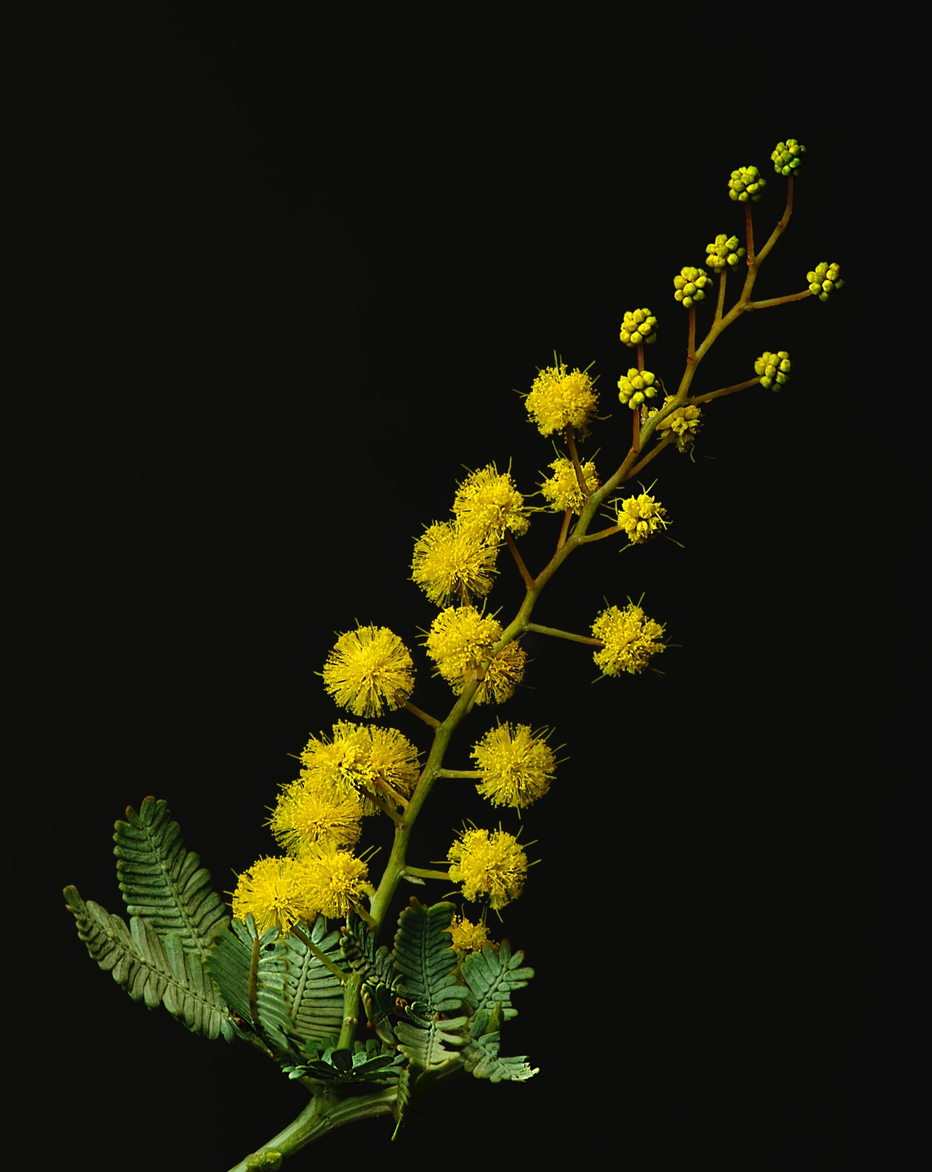
Depth –of-field

Slide 16
Triggering the Shutter
All remote triggering is aimed at having the camera completely still when the shutter is triggered to give the sharpest possible image
Cable release cords
Remote controls
Setting the self timer

Slide 17
Mirror Lock-up
Most digital DSLRs allow mirror lock-up
Used to ensure the camera is not vibrating when the shutter is triggered
Generally the first press of the shutter locks the mirror up and the second releases the shutter
Contributes to really sharp pictures

Slide 18
Questions
Time to start photographing

